Slide 1
Learning To Edit Code
Ph.D. Proposal Presentation
Saikat Chakraborty
Department of Computer Science
Columbia University.
Committee
Dr. Baishakhi Ray, Dr. Gail Kaiser, Dr. Kathleen McKeown, Dr. Junfeng Yang Columbia University
Notes:
Thanks Professor Ray for the introduction. Hello everyone, welcome to my Ph.D. proposal presentation. The topic of my dissertation will be “Learning to Edit Code.”

Slide 2
Automatic Code Editing
Notes:
Before moving on the details of the proposed topic, let us first recap the problem I am working on and formally define the problem. Let us also recap some of the background information.

Slide 3
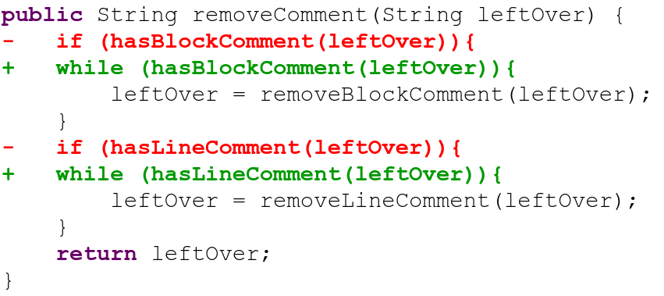
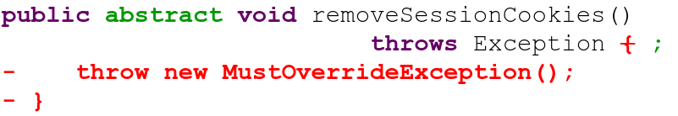
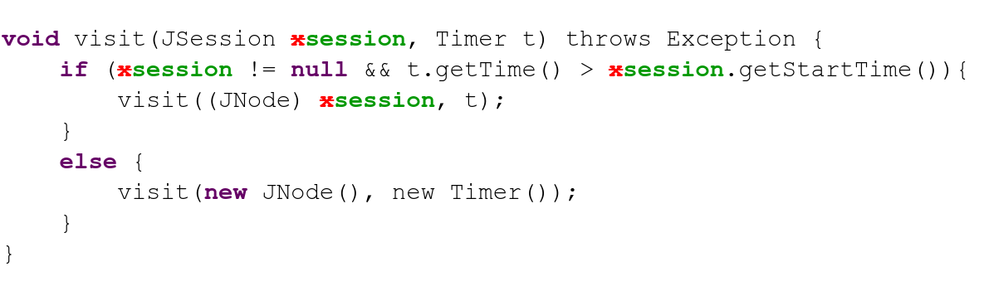
Adding Feature
Bug-fixing
Refactoring
Notes:
Developers edit code for different purpose. For instance, they edit code for adding new feature to their code base,
Or edit code for fixing bugs
Or edit code for refactoring existing code.

Slide 4
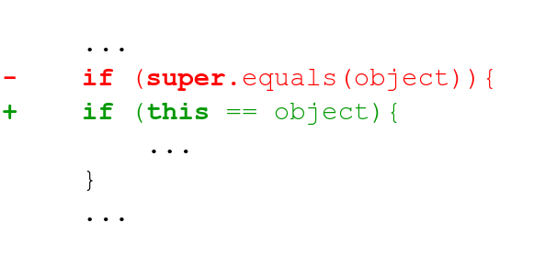
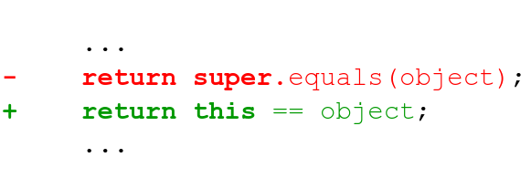
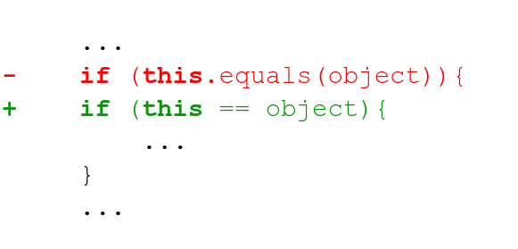
Code Edits Are Repetitive [Meng et. al. 2011, 2013], [Ray et. al. 2015]
Is it possible to
Automate
Such Code Edits?
Notes:
It turns out that code edits are repetitive, that is developers reuse same patterns of edit in different context over and over again.
Which leads us to investigate “Is it possible to Automate such repetitive code edits?” Let us see how we may design such an automated system.

Slide 5
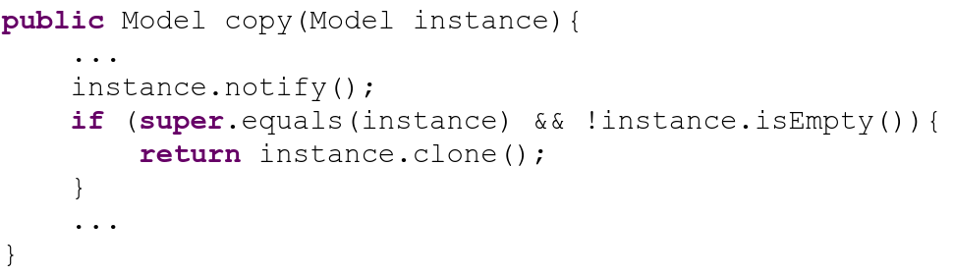
Automating Code Edits - Template/Search based
Edit Template
Match Found
Notes:
One possible way is to manually write edit template.
Then search for the template in code base,
Once a match is found,

Slide 6
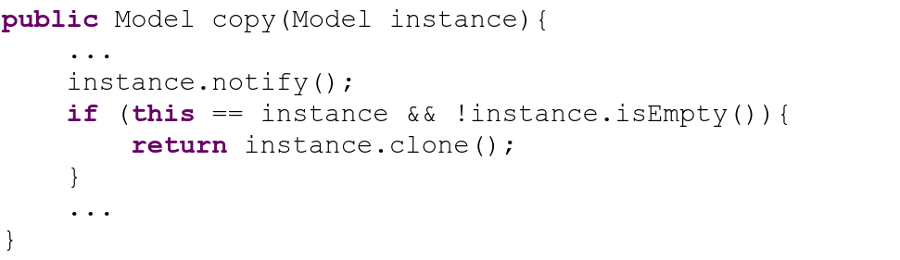
Automating Code Edits - Template/Search based
Edit Template
Patch Applied
Problems
Too many templates to write.
Bottleneck : Template Matching / Code Search
Notes:
Apply the Corresponding patch.
However, such approach has one problem, these templates are often hand coded and very tedious. Also efficacy of this approach highly depend on code search and template matching success.

Slide 7
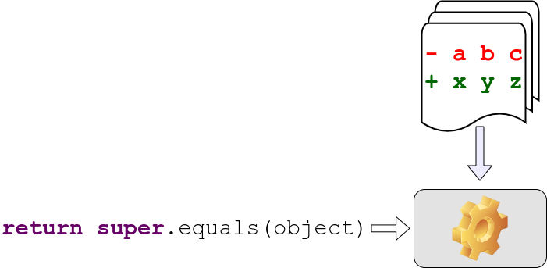
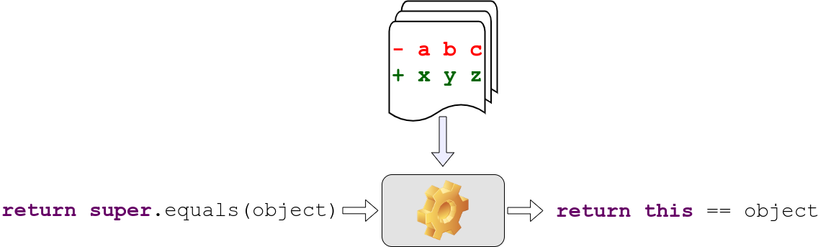
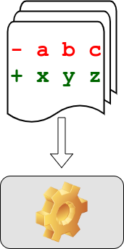
Code Editing Task - Learning Based Solution
Example Code Edits
Code Before Edit
Code After Edit
Notes:
Another way to solve this problem is to learn such Edit patterns.
In this solution, we train a machine learning model to learn code edit patterns from example edits.
After training, the machine takes in the Before Edit Version of the Code and
Translates it to Edited code, applying the change pattern in the process.

Slide 8
What are my Contributions?
Application in Automatic Program Repair.
3
Development of both Semi-Automatic and Fully-automatic Code Editor.
2
Identification of Technical Challenges in Learning based Code Editing.
1
Notes:
As I mentioned previously, the area where I am researching towards my Ph.D. is “Learning to Edit Code” That is designing systems that learns to edit code. With that being said, let us quickly go over the high level contribution I am going to make through my dissertation.
First, I identify the technical challenges to design a learning based code editing system.
Secondly, I work through those challenges to develop and build semi-automatic or fully automatic code editor.
And finally, I apply such tools for real world developments, for instance, automatic program repair.

Slide 9
Automated Code Editing - Existing works.
Template-based
Modern IDE (Eclipse, IntelliJ IDEA) - Refactoring, Boilerplate Code.
Meng et.al. - PLDI’11 - Infer edit template with graph matching.
Mutation Learning
Rolim et. al. - ICSE’17 - Designed a DSL for representing Edits.
Dinella et.al. - ICLR’20 - Neural Turing Machine.
Encoder-Decoder
Tufano et. al. - ASE’18, ICSE’19, TOSEM’19. - Abstract tokenization.
Chen et. al. - TSE’19 - Copy Attention based models.
Tufano et. al. - ICSE’21. - Multi-Encoder models.
Notes:
With that being said, let us quickly go over the existing works in automated code editing.
I divide the existing solutions in automated code editing into three broad categories. First Template based solutions where edit templates are manually written or mined from data. Modern IDEs use such approaches for refactoring and adding boilerplate code.
Second category are mutation on code is learned. Given a piece of code, a machine predicts most probable edit operation. And a machine learns to predict sequence of such edit operations to edit the original code to the final code.
Last, but not the lease, and this is the sub-area I concentrated my research on, is Encoder-Decoder based techniques. Where the Code Editor works like a code translator and apply the edit pattern in the form of translation.

Slide 10
Encoder-Decoder
Based Code Editing
What is it?
Notes:
Now, let us look details into Encoder-Decoder based Code Editing?

Slide 11
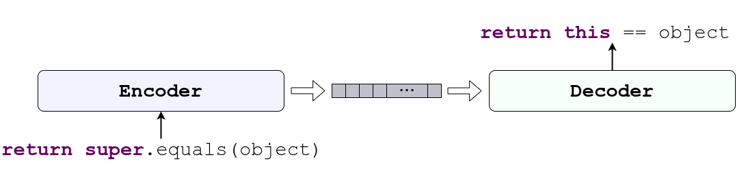
Code Editing with Encoder-Decoder
Encoder and Decoder learns
Code Edit Patterns from example edits.
Notes:
The Encoder-Decoder based code editor is a machine learning model which consists of a Code Encoder and Code Decoder.
Together they can learn the edit patterns from example edits and

Slide 12
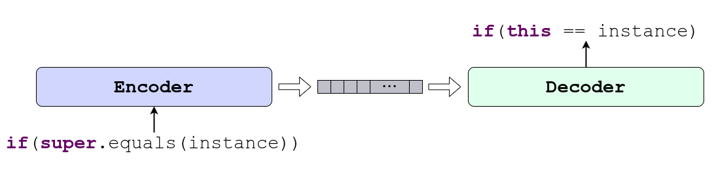
Code Editing with Encoder-Decoder
Encoder and Decoder learns to
Apply the Pattern in Similar Context.
Notes:
Once the encoder and the decode learns the edit patterns, they can apply the patterns in similar context. Now let us look at how the encoders and decoders work.

Slide 13
Code Editing with Encoder-Decoder
Encoder encodes the input code to a vector or matrix.
Decoder generates the edited code.
Notes:
The encode takes in the code before edit and encodes it to a vectorized representation
The decoder then generates the edited code from those vectorized representations.

Slide 14
Encoder-Decoder Based Code Editing
Where does my dissertation stand?
Notes:
Now that we formally defined encoder decoder based code editors, let me compare my contribution with respect to some of the existing techniques that uses encode-decoder based methods.

Slide 15



Method | Generate Concrete Code | Syntactic Correctness | Contextual Correctness | Multi Modality
M. Tufano et. al. ASE 2018, ICSE 2019
SequenceR - Chen et. al. TSE 2019
CODIT - TSE 2020
CodeBERT - Feng et. al. EMNLP 2020
PLBART - NAACL 2021
CoCoNut - Lutellier et. al. ISSTA 2020
R. Tufano et. al. - ICSE 2021
MODIT
ReCordit |  | Learning | Learning
Used/Guaranteed
Not Used
No guarantee
Empirical guarantee
Notes:
Here I list some existing techniques and evaluate four different properties of those techniques. The first category is whether or not the editor can generate concrete code, or just a template. If a method cannot generate concrete code, it may not be used as automated code editor. Second, I check whether the edited code is syntactically correct, third whether it is contextually correct. And finally, whether those approaches are capable of handling multi-modal information that is different source of input information.
Among these CODIT, which is published in TSE 2020, PLBART, which is published in NAACL 2021, and MODIT, which is a work in progress are going to be part of my dissertation.
As I am designing techniques for source code analysis, I should consider the properties of the source code, and let us revisit what properties of the source code should we consider while building such a model.

Slide 16
Desired Properties of
Encoder and Decoder
Notes:
In particular, let us recap what properties should the encoder and the decode exhibit. But Let us look at different properties of code first.

Slide 17
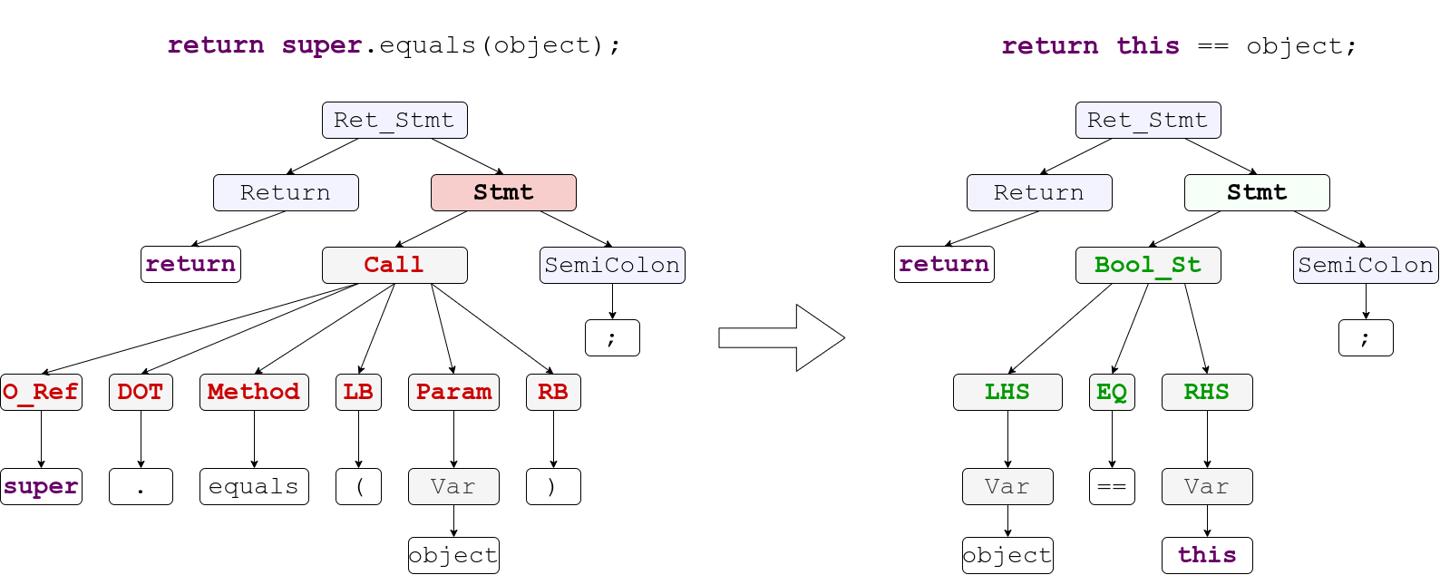
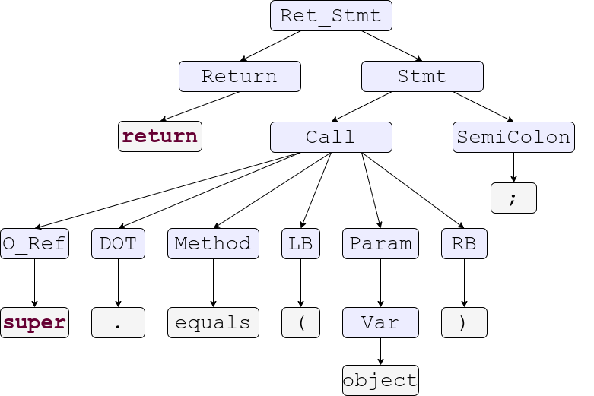
Properties of Source Code.
Code are
Highly Structured.
Invisible properties. e.g. Non-Terminals
Notes:
Let us consider this line of code. I looks like Just a plain simple line of code. But is it just the code?
When we parse the code, we get a syntax tree.
Which means code is not a flat sequence of tokens
it is highly structured.
There are lot of properties of code which are invisible in the face value of the code. for instance, when we write code, we do not see the non-terminals, but every parsable code has non-terminals in its structure. And these non-terminals really defines the meaning of the code.

Slide 18
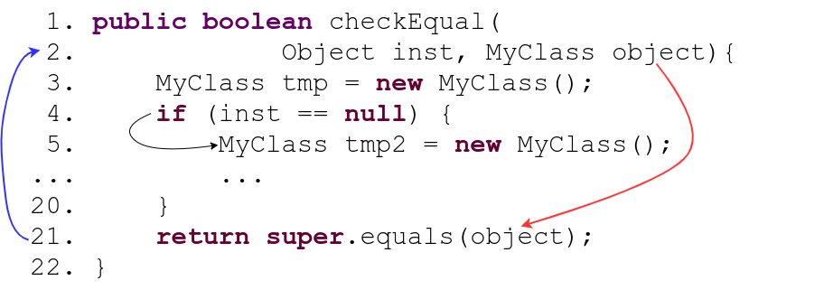
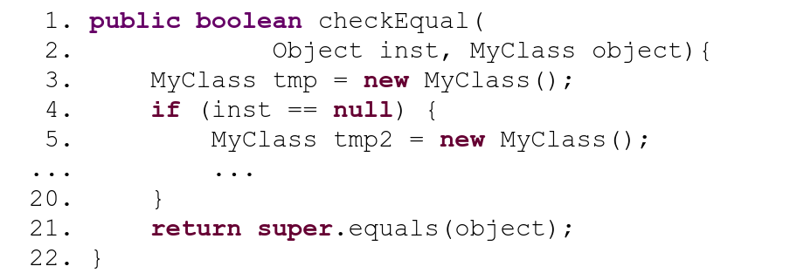
Properties of Source Code.
Control
Data
Long Range Relation
Notes:
Furthermore,
Different components of source code may contain
Different dependencies. For instance,
Control Dependency
Data dependency
Some of the relations between code components can be very long distance. For example, in this case variable object is declared in line 2 but used in line 21.

Slide 19
Desired Properties of the Encoder
Source Code
Understand
Long Range Relations
Understand Structure
Understand Dependency
Notes:
Thus, To fully understand the code through an encoder, the encoder model should
Understand the structure
Understand the dependency
And understand the long range relations. Now we will see the properties of the Decoder

Slide 20
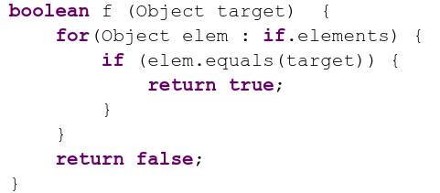
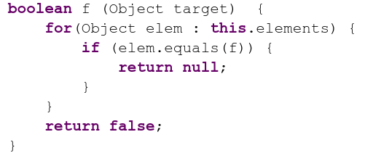
Desired Properties of the Decoder
Syntactic correctness.
Contextual correctness.
Syntactically Incorrect
Contextually Incorrect
Notes:
Since the Decoder is essentially a code generator, It should ensure syntactic correctness and semantic or contextual correctness. To understand up what I meant by these correctness properties, let us look at some counter examples.
This is a syntactically incorrect code. Because
Of this misplaced if token. If a model makes one such mistake, the whole code is practically useless.
This code is contexually incorrect because
A function name is passed as parameters of another function.
Also, even though the return type of the function is boolean, the generated function is returning null. When these code are passed through a compiler, the first one will result in a syntax error by the compiler, and the second one will result in a semantic error. Nevertheless, now that we know the bar of expectation from both the encoder and decoder, let us dive into my research.

Slide 21
1
Enforcing the Syntactic Correctness
CODIT: Code Editing With Tree Based Neural Models - TSE 2020
2
Learning the Contextual Correctness
Unified Pre-training for Program Understanding and Generation - NAACL 2021
3
Leveraging Auxiliary Information
On Multi-Modal Learning of Editing Source Code - ASE 2021
4
Learning Program properties in multi modal editing
Reinforcing Program Properties for Multi-Modal Source Code Editing
- Work in Progress
Notes:
I am proposing three different components in my dissertation. First, where I designed a model for enforcing syntactic correctness.
In second component, I present technique where we learned Contextual Correctness,
In this third component, I present a technique which combines multiple information source in a multi-modal learning fashion. Before moving to the first component, let us quickly visit what are the problem we wanted to solve in CODIT, that is what was missing in the state of the art that time.

Slide 22
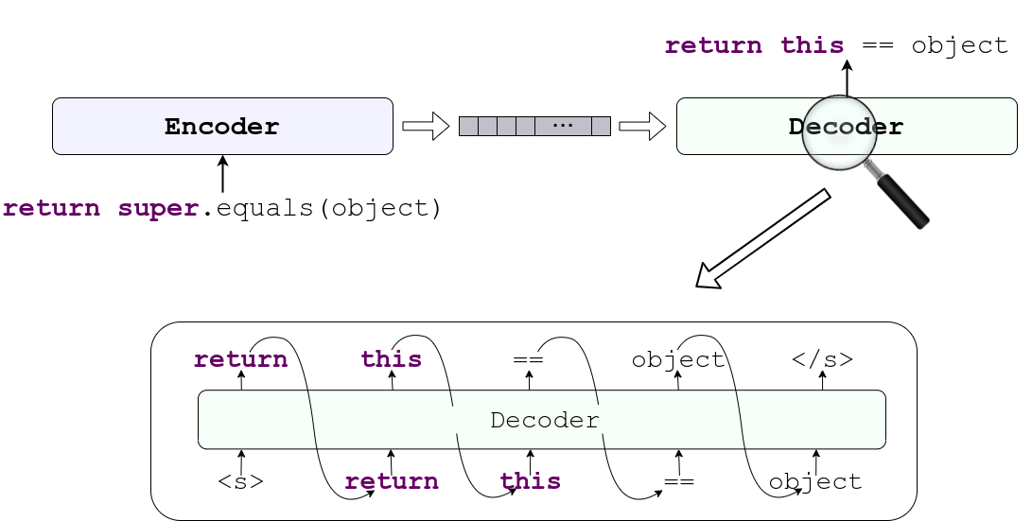
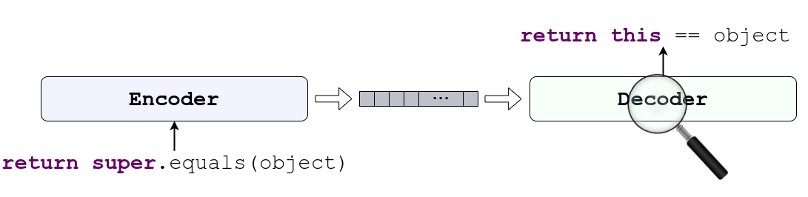
Code as sequence of tokens [Tufano et. al. 2018, 2019]
Recurrent Network for both Encoder and Decoder
Notes:
A simple way to implement Encoder-decoder based Code Editot is to use Recurrent Neural Network based Encoder and Decoder, where both of them treats code as a mere sequence of tokens. An approach proposed by Tufano et. al. used Recurrent Neural Network to encoder and decode code, in both case as sequence to tokens. But such treatment would cause certain problems.
To understand the problem, Let us put a closer look at how the decoder generates the edited code.
The decoder generates the edited code sequentially one token at a time. While generating a token, decoder only relies on the output of the previous step and the internal state of the decoder. The internal state supposedly contains all the information of everything that had been generated before that particular token.

Slide 23
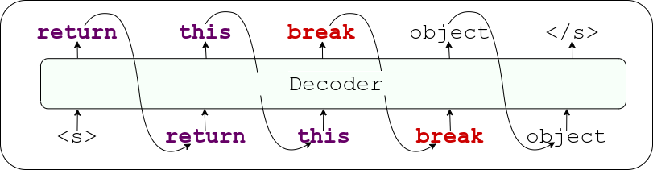
Code as sequence of tokens [Tufano et. al. 2018, 2019]
Problem?
Notes:
Since RNN based decoder “ONLY” remembers what it had generated so far through its internal state. There is always a chance that the decoder can generate a wrong token in a certain position.
And that’s a problem, because, one wrong token could make the whole edited code syntactically incorrect, and no matter how correct the system works before or after that wrong prediction, the whole edited code is practically useless. With this problem stated, let us move onto CODIT.

Slide 24
CODIT: Code Editing With Tree Based Neural Models
TSE - 2020
Findings
Generation of Syntax Tree instead of code Guarantees Syntactic Correctness.
Contribution
Tree/Grammar Based Model for Automatic Code Editing.
Notes:
The first component of my dissertation is CODIT: Code Editing with tree based neural models published in TSE 2020
Our major finding in this paper is the Generation of Syntax Tree instead of code Guarantees Syntactic Correctness. And it can be achieved with the help of Context Free Grammar of the Programming Language.
Our major contribution in this paper is that we designed a hierarchical Syntax Tree based model for learning code edit patterns.

Slide 25
Is it possible to Edit Code with
Guaranteed Syntactic Correctness?
Notes:
In this research we ask the question Is it possible to Edit Code with Guaranteed Syntactic Correctness?

Slide 26
Generate Syntactically Correct Code
Notes:
We want to enforce syntactic correctness inside the decoder so that it generates code that are syntactically correct.

Slide 27
Generate Syntactically Correct Code
Notes:
Recall from Compiler-101, a code is syntactically correct
as long as it can produce a syntax tree. Thus, we change the perspective of code a little bit while designing CODIT, instead of viewing code as token sequences, CODIT sees code as syntax trees.

Slide 28
CODIT: Code Editing With Tree Based Neural Models
Code Before Edit
Code After Edit
Notes:
We design Codit, which is a tree based encoder decoder model.
Codit first into extract the syntax tree of the code before the edit
Codit then translate it to the syntax tree after edit.
And finally, codit converts the edited syntax tree to the edited code. By generating syntax tree, codit guarantees that that edited code is syntactically correct. Now let us look a bit in depth into the working process of Codit. Codit works on two step process.
In first step, Codit translates the structure, and
in second step Codit generates the Edited code.

Slide 29
CODIT Step 1
Tree Translation
Notes:
Let us see the step 1 that is the tree translation.

Slide 30
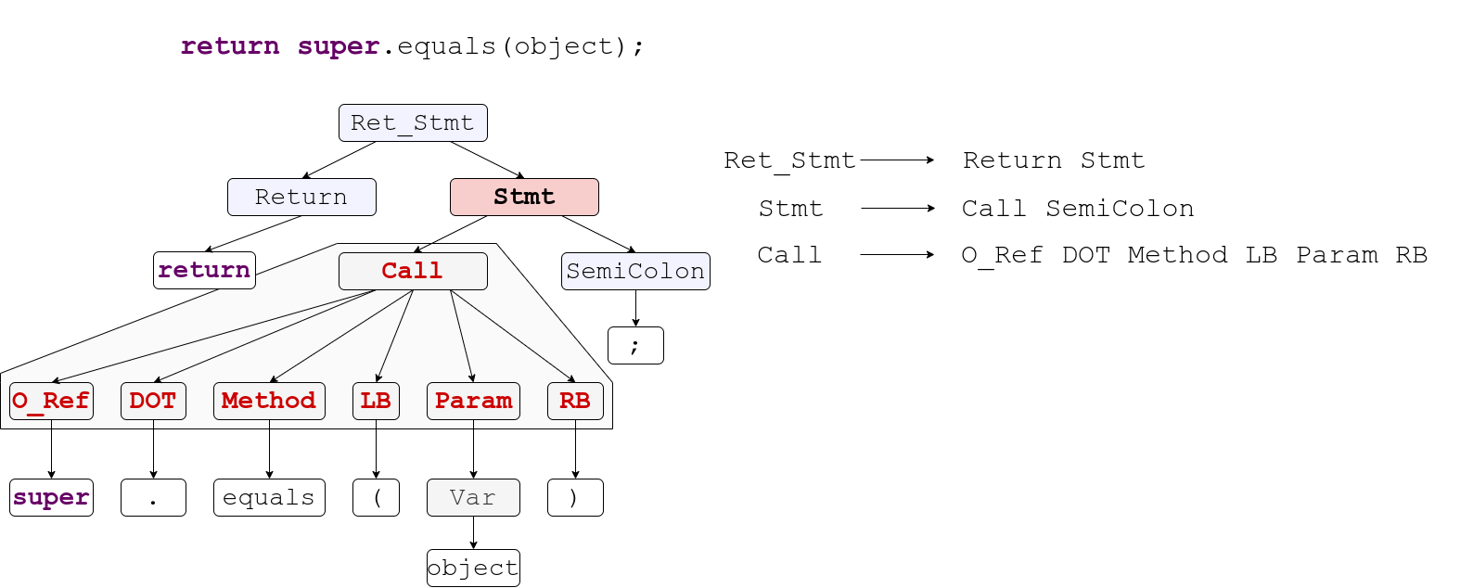
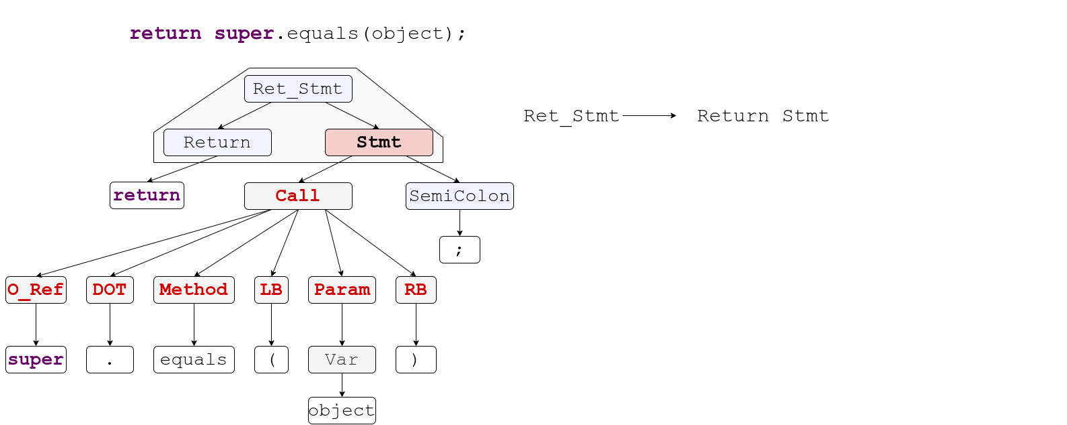
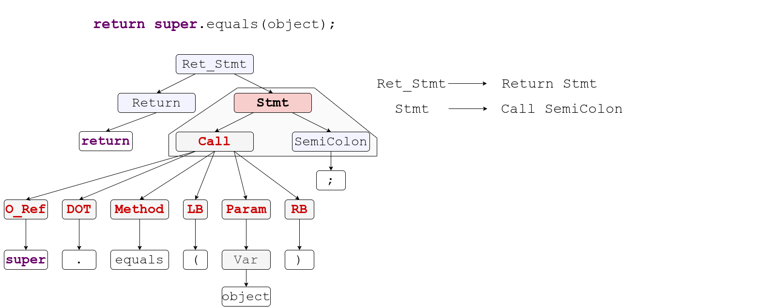
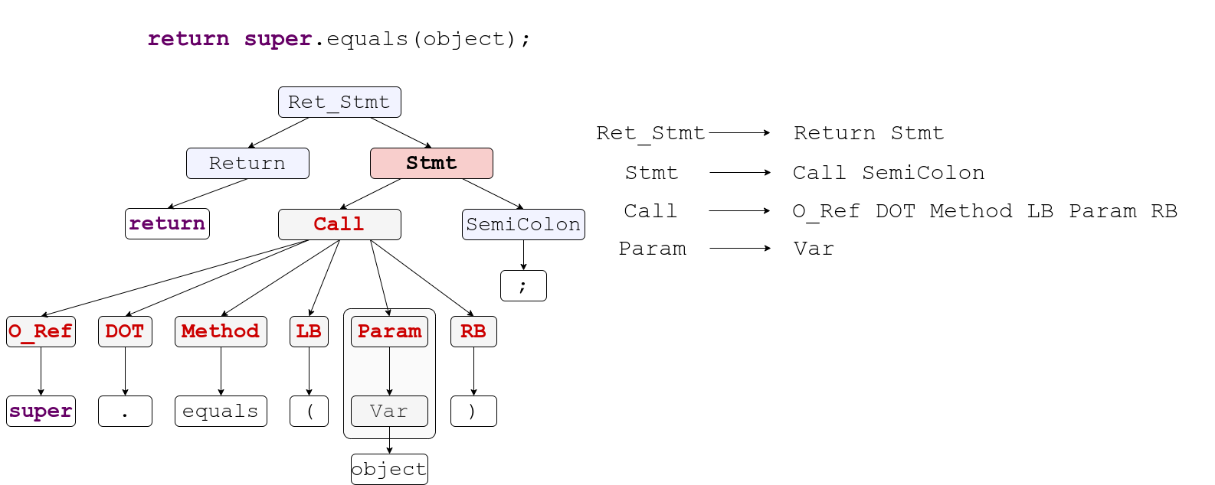
CODIT: Code Editing With Tree Based Neural Models
Notes:
Also recall from the Compiler 101, syntax tree is a collection of production rules from the language grammar applied sequentially to the root node to derive the tree.
To encode the syntax tree,
we extract those grammar production rules
That make up the tree
of the programming language as a sequence. If we apply these rules sequentially, we can derive the tree structure corresponding to this code.

Slide 31
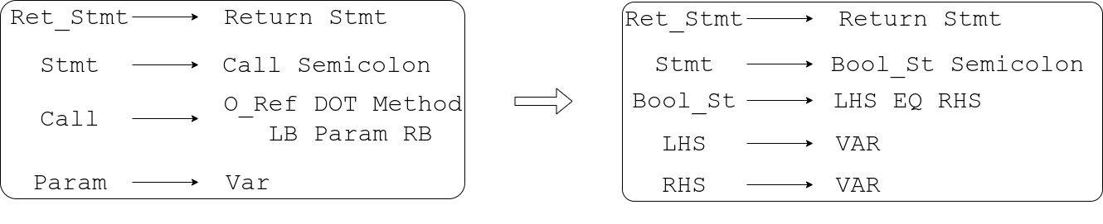
CODIT: Code Editing With Tree Based Neural Models
Rules sequence of
Syntax Tree before edit
Rules sequence of
Syntax Tree after edit
Notes:
Once, trees are converted to sequence of rules, Codit then translates the before edit version of the rules to the sequence of rule corresponding to the after edit version of the code.

Slide 32
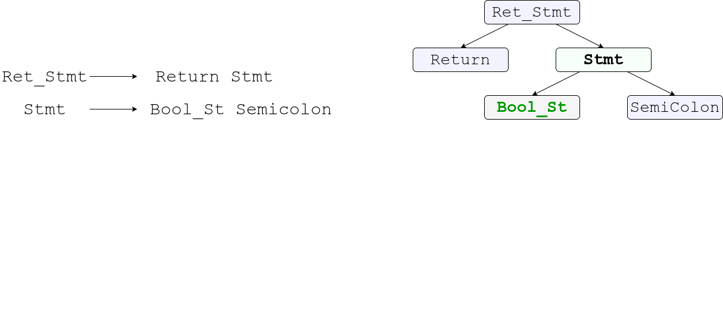
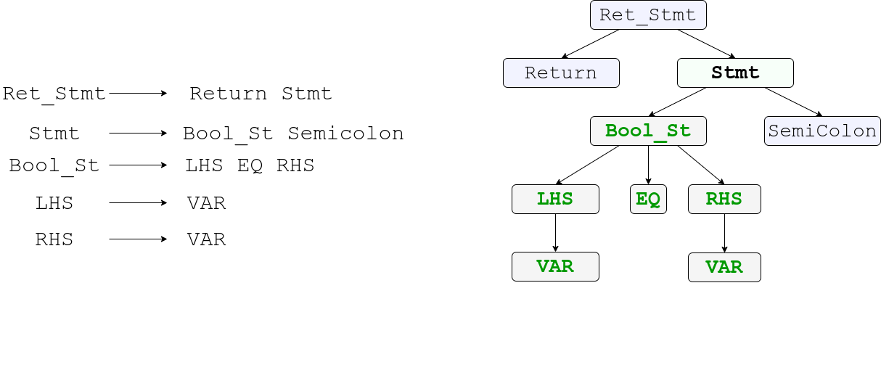
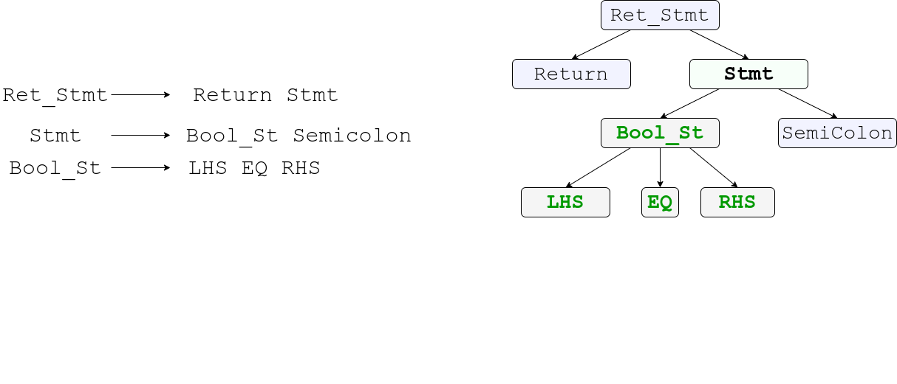
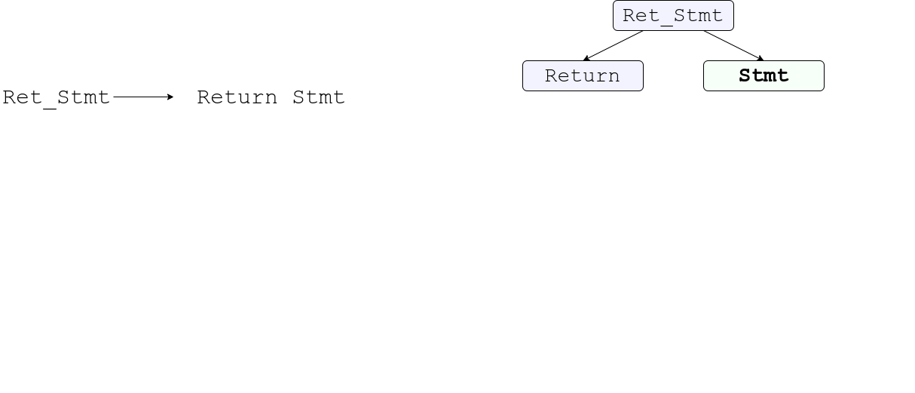
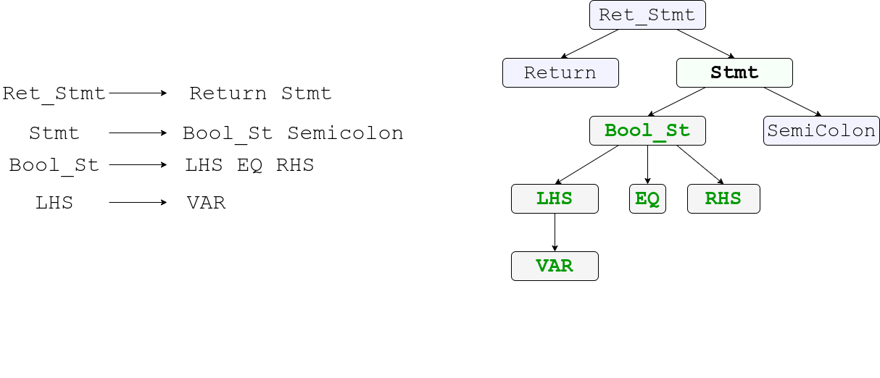
CODIT: Code Editing With Tree Based Neural Models
Notes:
From those generated rule sequence, Codit takes one rule at a time and grows the syntax tree in leftmost derivation fashion.
CODIT takes a rule and expands the leftmost bottommost non terminal node.
At any point, if the rule head does not match with the node to be expanded,
codit can ignore that rule, or chose an alternative one.
Codit stops when there are no more non-terminal node to be expanded. That is the tree is fully grown.

Slide 33
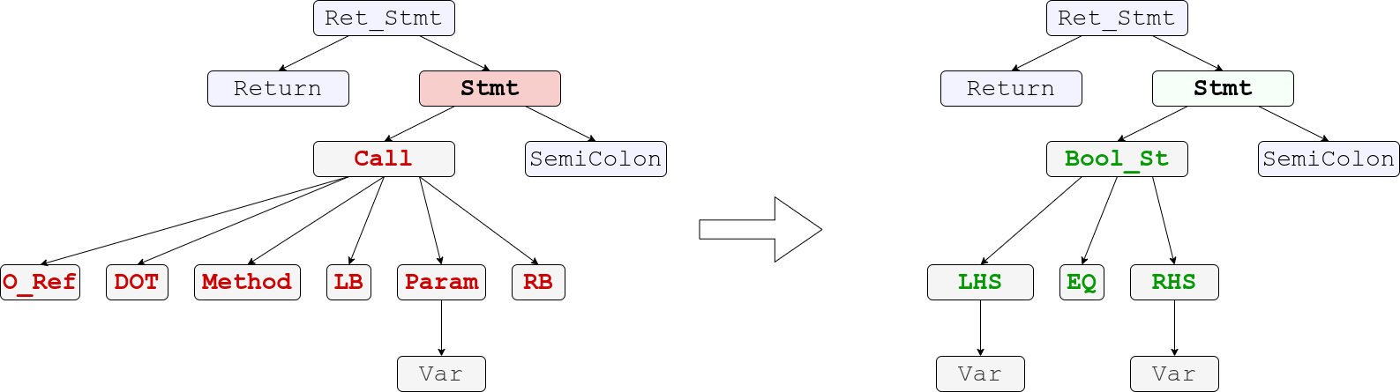
CODIT: Code Editing With Tree Based Neural Models
Notes:
Thus, essentially by translating sequence of rule,
we are translating the structure of the code and ensuring that the generated structure is syntactically correct.

Slide 34
CODIT: Code Editing With Tree Based Neural Models
Still not a complete code.
Notes:
Now that, we translated the structure,
The serialized terminals are supposedly the code itself.
Yet, as of now, it is not a complete code, the tokens are missing.

Slide 35
CODIT Step 2
Token Generation
Notes:
That bring Step 2 of Codit the Token Generation

Slide 36
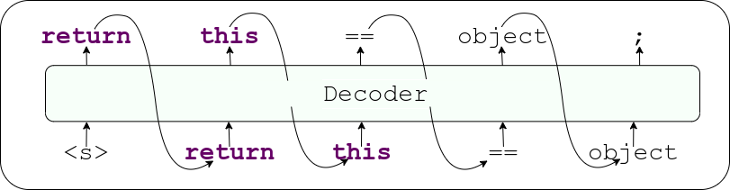
CODIT: Code Editing With Tree Based Neural Models
Restricted By Grammar
Token Translation
Notes:
We can now use a sequential token generator, where we can only search for feasible tokens based on the terminal node type.
Thus we design a token translation model, where we restrict the search space for every token based on the terminal node type generated by the tree. Note that this is also an RNN based encoder decoder model, with terminal node type as auxiliary input for every token. In this model where we are generating code sequentially, but restrict the possible token based on the corresponding terminal type.
For instance, in case of the terminal EQ, the only possible token to generate is the equality operator.
For most of the token types, the grammar restricts the possible token set.

Slide 37
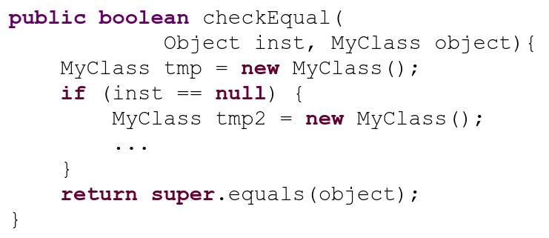
CODIT: Code Editing With Tree Based Neural Models
Reachable Variables in Edit Location:
{inst, object, tmp}
Edit Location
Notes:
However,
in the case of identifiers, it is a bit tricky. Identifiers can be anything.
But, we do not use random identifiers at random positions. Instead, while editing a code, we reuse variables that are in scope.
To get the variables that are in scope, we perform reachability analysis in the Edit location.
We only use those variables and method names that are reachable in the edit location.
For instance, for generating this edit, CODIT does not consider variable tmp2 since it is not reachable in the edit location.

Slide 38
CODIT
Evaluation
Notes:
Now let us move on to the evaluation of Codit

Slide 39
CODIT: Code Editing With Tree Based Neural Models
Study Subjects
Data Set | Number of Projects | Number of Edit Examples | Code Fragment Size
 |  |  | Number of Tokens | Number of Nodes
Generic Code Edit from Github | 48 | 32,473 | Max - 38 Avg - 15 | Max - 47 Avg - 20
Pull Request Edits [Tufano et. al. 2019] | 3 | 5546 | Max - 34 Avg - 17 | Max - 47 Avg - 23
Notes:
We evaluated codit on two different datasets. First one generic code edit from github which contains 48 projects a little more than 32 thousand edit examples. And next is pull request edits with 3 projects and five and a half thousand edit examples.

Slide 40
CODIT: Code Editing With Tree Based Neural Models
Results (Accuracy in top 5 edited code)
Method |  | Generic Code Edits | Pull Request Edit
Sequence Based | LSTM-Seq2Seq | 3.77% | 11.26%
 | Tufano et. al. | 6.57% | 23.65%
 | SequenceR | 9.76% | 26.43%
Tree Based | Tree2Seq | 11.04% | 23.49%
 | CODIT | 15.94% | 28.87%
Notes:
We evaluated Codit against two types of models. First we consider model where both encoder and decoder treats code a sequence of tokens. In this group, we have three baselines. LSTM-Seq2Seq is a vanilla LSTM based model. Next one of also LSTM S2S model working on abstracted code Tufano et. al. and the third one is SequenceR which a also a LSTM seq2seq model with copy attention.
To understand tree based modeling, we compared CODIT with a tree2seq model which uses a tree based encoder and sequence based decoder to generate edited code.
Codit promising result over the sequence based baselines shows the effectiveness of tree based modeling. Codit’s better performance over tree2seq model shows the importance of using tree based model both as encoder and decoder.

Slide 41
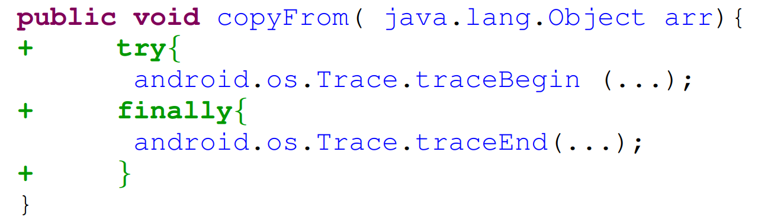
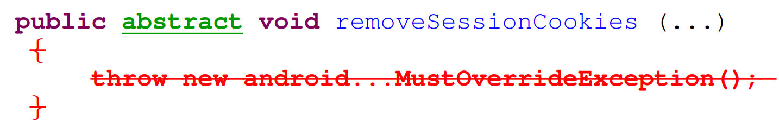
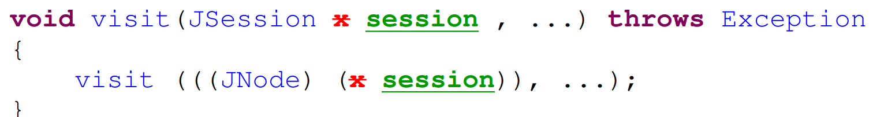
Example Edits
Addition
Deletion
Update
Notes:
Let us look at some example Edit Codit generates.

Slide 42
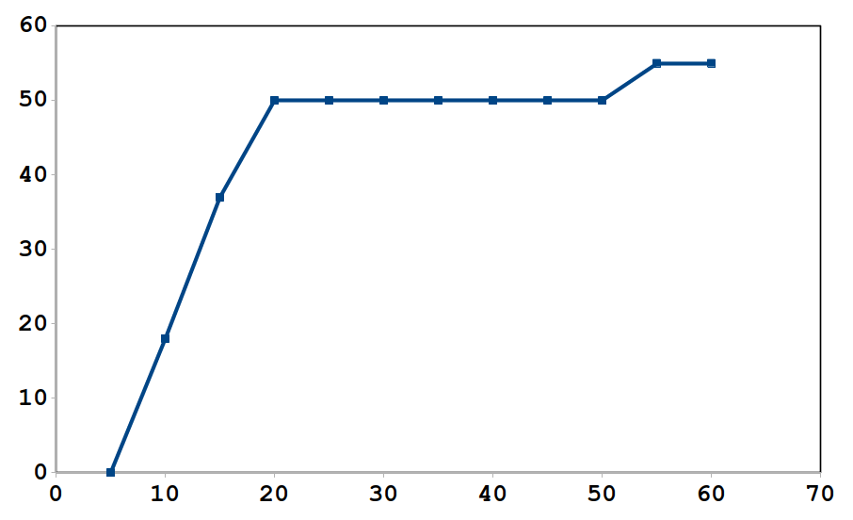
Application - Automatic Program repair
CODIT fixes 15 bugs completely and 10 bugs partially, out of 80 bugs in Defects4j.
Number of Patches
Time (minutes)
Notes:
We applied Codit for bug-fix code edits. Out of 80 bugs in defects4j dataset, Codit successfully fixed 15 bugs completely and 10 bugs partially,
And the graph shows how quickly Codit can generate patches that passes bug reproducing test cases. And within 20 minutes Codit generated patches 50 bugs that passes at least the bug reproducing test cases.

Slide 43
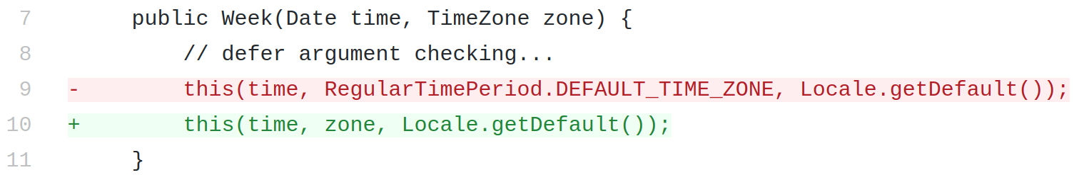
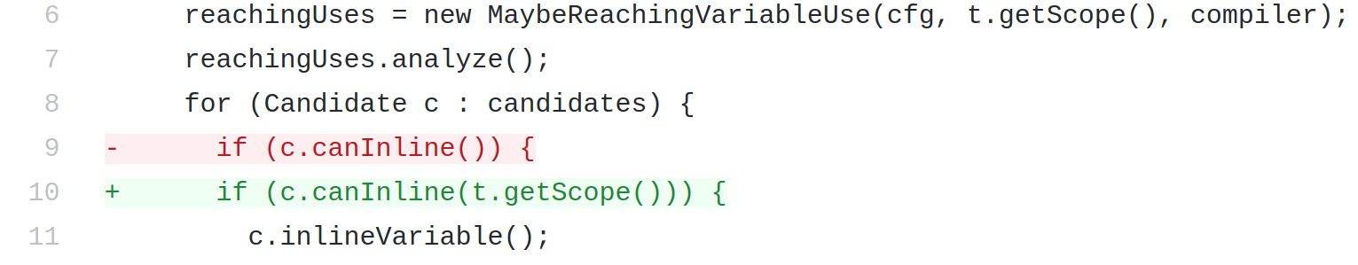
Application - Automatic Program Repair - Examples
JFreeChart: Bug-8
Closure Compiler: Bug-3

Slide 44
Take Away Point
Generating Syntax Tree Guarantees Syntactic Correctness of Edited Code.
Notes:
So the take away point from this research is that

Slide 45
Contexual Correctness:
Is it there?
Notes:
Remember the contexual correctness we discussed earlier, what happen to that? Is it there in CODIT? Let us see some examples

Slide 46
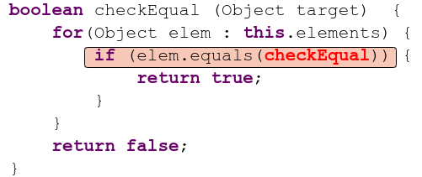
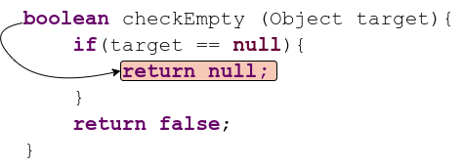
Wrong Identifier
Wrong Return Type
Notes:
These are the edited code generated by CODIT. While all of these are syntactically correct (i.e. we get syntax tree for these code) they are not really contextually correct. Some code use function name in place of a variable. Some generates wrong data or return type. Thus the problem of contextual correctness is still there. Now let us take an attempt to solve this problem. That is let we investigate whether we can learn contextual correctness.

Slide 47
Is it possible to learn
Contextual Correctness?
Notes:
Moving on, we now investigate, Is it possible to learn Contextual Correctness?

Slide 48
Unified Pre-training for Program Understanding and Generation (PLBART)
NAACL - 2021
Findings
Contextual Correctness can be learned from large scale source- code dataset.
Contribution
Developed large scale pre-trained models for different SE tasks.
Notes:
The paper I am going to discuss not us Unified Pre-training for Program Understanding and Generation (PLBART) accepted to be published in NAACL 2021.
Our contribution in this paper is that Developed large scale pre-trained models for different SE tasks.
The major findings in this paper is Contextual Correctness can be learned from large scale dataset. Now let us see some of the motivation behind PLBART.

Slide 49
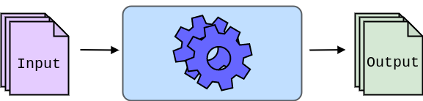
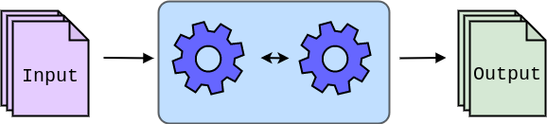
Code Before Edit
Code After Edit
Language Model
Edit Model
Language Model
Notes:
Let us look at the idea behind this work. In general terms, For a model that transforms an input to output of code editing task
there are two sub tasks. A portion of the model understands the input and generates the output, and another portion reasons about the Edit patterns.
In another word, the first part is more of a Language model, the second part is more of a edit model.Though, these two parts of a model are not explicit and often these parts interact with each other, we can conceptually subdivide any model in this way. So far, we have seen that we trained these two parts together.
However, the language model, that is the portion of the model that learns to understand and generate the language does not depend on the code editing task.

Slide 50
Pretraining - Embed the knowledge of input and output into the model.
Notes:
A very similar idea to embed the knowledge about the input and the output into the model is Pretraining. That is, we can train a pre-train a model how to understand the source code, and how to generate source code. One very important thing to note here is that, Like I mentioned before learning to understand or learning to generate code does not depend on the task. That is, for pretraining a model how to read or write code, we do not need example edits. There are billions of lines of code in guthub and in other open source repositories, which we can use for pretraining such a model. Of course, the objective of such pre-training is like teaching the model what is a source code, what is the syntax, how to write a for look, how to catch exception etc.

Slide 51
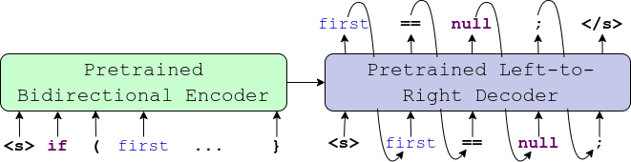
PLBART - Pretraining both encoder and decoder.
Encoder
Decoder
What Type of Model should we use?
Notes:
Thus, we come up with and encoder decoder model which we pre-trained for simultaneously understanding code and learning to generate code. However, there are few design decisions that we had to consider
Choice of model - Transformer Model
Pre-training Training Objective

Slide 52
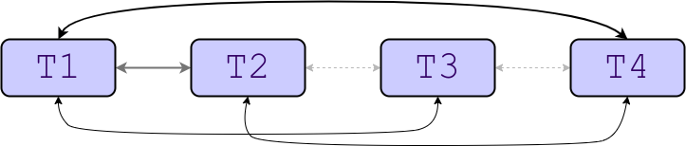
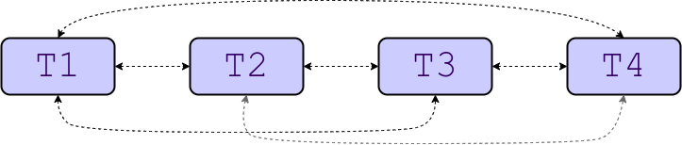
Recurrent Model Vs. Transformer Model
Recurrent Model
2. Transformer Model
T4
Notes:
Before deciding the choice of model in PLBART, let us recap on conceptual view of recurrent models and transformer models. And see how transformer model itself solves some of the problems in recurrent model.
Recurrent model processes one token at a time. While processing a tokens It depends on the input and its internal state.
As we can see here, There is not direct connection between T1 and T4.
T4 knows about the information about T1 through the internal state of the RNN.
1click
2click
3click
In contrast, in Transformer model,
every token are softly connected to each other. Conceptually, transformer is a fully connected graph, where nodes are tokens in a sentence, and edges are attention weights between the tokens.
As part of the training process, the nodes learn which token depend on what other tokens and by how much.
Since every token could be connected to every other tokens, the transformer is able to learn very long range dependency.
For instance, here T4 directly gets T1’s information since they are directly connected.
Moreover Transformer also model multi-head attention, which is conceptual equivalent to having multiple dependency edges between components of code. Since Transformer implicitly models the input as a graph with provision for multiple type of edges through attention, we believe that Transformer is the right choice of model for PLBART.

Slide 53
PLBART - Pretraining both encoder and decoder.
Encoder
Decoder
How do we train PLBART?
Notes:
Now the next question is
What objective should we set for training PLBART?

Slide 54
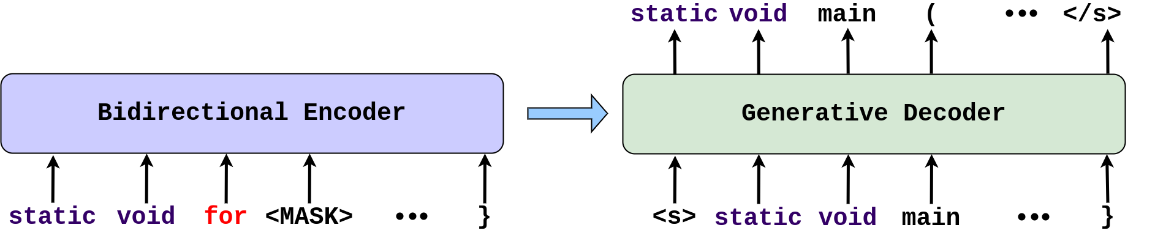
Unified Pre-training for Program Understanding and Generation
Denoising Auto-Encoding
Noise Removed Input
Noise Induced Input
Type of noises
Replaced Token
Masked Token
Notes:
We use denoising autoencoding for training PLBART.
Where we provide noise induced inputs to the encoder and
expect the decoder to generate noise free version of the given input.
The type of noises that we used in PLBART are
Replaced token -- where we randomly replace some tokens from the input with different token.
Masked token = randomly mask out some tokens. Other noising strategies can include token deletion, selective token masking, etc. Nevertheless, let us move onto discussing how PLBART model works.

Slide 55
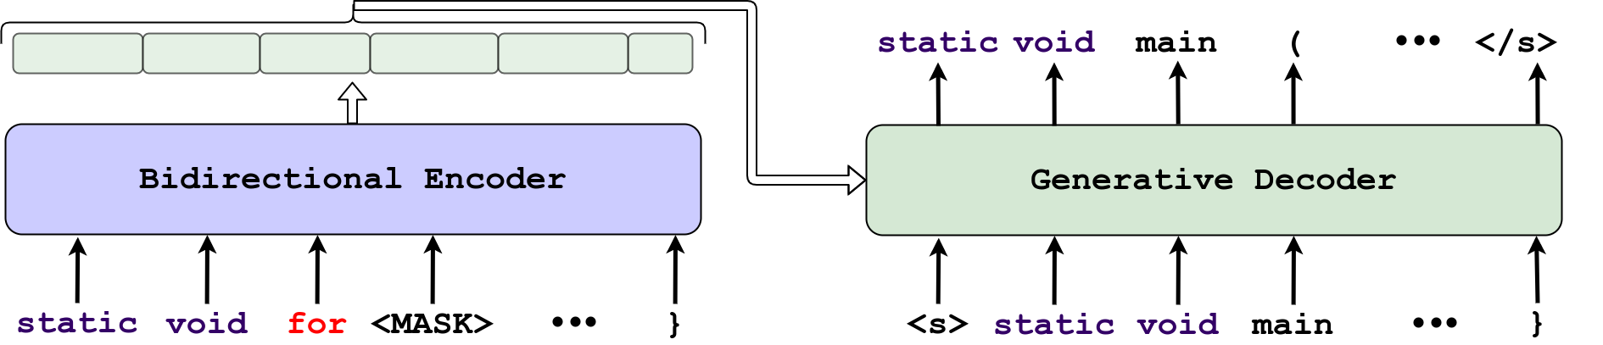
PLBART - what is it learning?
Encoder
Learns the input structure implicitly.
Learns long range dependencies.
Decoder
Learns to generate correct code
Learns to reason about any missing and misplaced token in input.
Notes:
Thus, we believe that The encoder learns
Learns the input structure implicitly.
Learns long range dependencies.
And the decoder
Learns to generate correct code
Learn to reason about any missing and misplaced token in input.

Slide 56
PLBART
Evaluation
Notes:
Having discussed the technical details of PLBART, let us move onto evaluation.

Slide 57

Downstream Tasks
Notes:
First, these are the downstream SE tasks we evaluated PLBART on.
While we evaluated PLBART on five different types of downstream SE related tasks, today I am going to discuss the results of Program Repair in PLBART

Slide 58

Code Editing (Program Repair) Result
Dataset: Tufano et. al. 2019
Metric: EM (exact match) in Top-1 position
Small - Upto 50 Tokens
Medium - 51-100 tokens
Small
Medium
Notes:
For Program Repair task, PLBART generates

Slide 59
Take Away Point
Large scale model and pre-training for code generation help generate contextually correct code.

Slide 60



Notes:
Suppose a software developer wants to modify their code.
In particular, they want to change this line. Now, this line can be changed in many different ways.
For instance, the ArrayList can be replaced by either the hashset or
It can be replaced with LinkedList.

Slide 61

Notes:
Now the machine working for the developer is confused. The machine does not know which one to take, both of them are syntactically and semantically correct.

Slide 62

Notes:
Then the developer tells the machine about their intention as a guidance.

Slide 63

Notes:
Now the machine can decide, this is the correct patch, not the other one. And the developer is happy

Slide 64

Developers Guidance
Notes:
Thus, a guidance or some hints from developers can be a very important signal for code editing.

Slide 65

Context
Notes:
Further, if we look at this code snippet, from the guidance, we get a hint that there should be a check of empty object. But which object we should check for, we have no clue.
However, if we look at the context, we get an idea that
The jsonObject should be checked for being empty.
Thus, context could be a major help for finding code element while synthesizing the patch.

Slide 66
Notes:
In fact, while synthesizing the edited code,
existing ingredients from both the context and the guidance could help the patch synthesizer.

Slide 67
MODIT : Multi-Modal Learning of Editing Source Code
Work in progress
Findings
Developer Guidance and Context of Edit are very important for Automated Code Editing.
Contribution
Leveraging multiple information modalities to Automate Code editing, and identification of best way of processing such modalities.
Notes:
With these motivations, I am proposing MODIT : Multi-Modal Learning of Editing Source Code as my next and final component of my dissertation. The contribution I am proposing through MODIT are

Slide 68



MODIT : Multi Modal Code Editing (overview)
Encoder
Decoder
Notes:
With the intuitions, we built a multi modal code editing engine Modit, which works on three different modalities. Our First modality is, the code that needs to be edited. Our second modality is the the context of the edit, and last but not the least, the guidance in the form of text. We solve the problem as Encoder decoder based method.
First we concatenate the input modalities an for input to the Encoder
And then a decoder is used to generate the edited code.

Slide 69

MODIT : Multi Modal Code Editing (pipeline)
Notes:
More specifically, given the input modalities
We concatenate and tokenize them
Then we use a transformer based encoder decoder
Finally, we take the decoder output and post process then to generate the final edited code. Now let us move on to the the experiments.

Slide 70
MODIT
Evaluation
Notes:
Having discussed the technical details of PLBART, let us move onto evaluation.

Slide 71

Experiments : Dataset (Tufano et. al. ICSE 2019)
Notes:
We evaluated MODIT on two different dataset. These datasets are proposed by Tufano et. al. at ICSE 2019. These are bug fix commits collected from GitHub. Each examples comes with a code before a commit, code after a commit and the commit message. Since getting real textual guidance for evaluation is difficult, we used commit message as a surrogate for guidance.

Slide 72

(PLBART)
Notes:
Now, let us discuss some of the implications of the results we have observed in this research question.

Slide 73
Takeaway - Multi Modality Improves Code Editing
Notes:
And last but not least, Multi Modality improves code editing performance irrespective of what pretrained model we use.
As we can see, no matter
What model
We use
Multi modality always helps.

Slide 74

Impact of Different Information Modality.
Notes:
In the next research question, we evaluated the effect of three different modalities.
If we remove the Context from MODIT’s pipeline, the performance decreases from full MODIT
If we remove Guidance, the performance also decreases.
If we remove both the context and guidance, the performance fall even more.
We did another experiment, where we only took the context. This settings is similar to SequenceR proposed by Chen et. al. (TSE 19).
Even there, the guidance improves the performance. Now, let us look at some qualitative examples similar to the one we saw at the beginning of the talk.

Slide 75

Impact of Different Information Modality.
Impact of Guidance
Notes:
As we can see here, without the guidance, MODIT generates an incorrect patch.
But with the guidance model is able to predict correctly.

Slide 76

Impact of Different Information Modality.
Impact of Context
Notes:
In this example, MODIT generates a wrong patch without the context.
MODIT is able to generate right patch with the context, since the variable for the right patch, that is the variable sent is actually present in the context. With the results, we conclude that, both the guidance and the context are necessary to successfully generate edited code.

Slide 77
Best way to encode input Modalities.
Notes:
Finally, we investigate what is the best strategy to encode multiple input modalities?
In MODIT, we simply concatenated all three inputs as a sequence and used “ONE” encoder to encode such sequence.

Slide 78

Best way to encode input Modalities.
R. Tufano et. al. - ICSE 2021
Notes:
An alternate approach could be using three different encoders to encoder three input modalities. This approach is similar to what Rosalia Tufano et.al. proposed in their ICSE 2021 paper.

Slide 79

Best way to encode input Modalities.
Notes:
We did two different experiments to understand the effect of the number of encoders
First, we use all three modalities, and used three encoders for each. As we can see single encoder results in the best performance.
Second, we take just the code before edit, that is ep and the guidance that is G. As we see, in this case as well, single encoder results in the best performance.

Slide 80


Best way to encode input Modalities.
Notes:
As we know transformer models learn representation with attention between all tokens in the input. When we use different encoders for different inputs, it can only learn within the input. For instance, here, X1 depends only on X2. Y1 depends only on Y2, There is no chance for interaction between Xs and Ys.
However, when we use one single encoder for all the input modalities, the model learns the representation with respect to other modalities as well. In this case, X1 not only depends on X2, but also on Y1 and Y2. Thus we conclude single encoder results in better representation.

Slide 81
Take Away Point
Multi-Modal input improve automated Code Editing. Using One single encoder is the best way to encode multiple modalities.

Slide 82
No Source Code Specific training in PLBART and MODIT?
Is it Enough?
Notes:
Now that, we can generate edited code that is syntactically and semantically correct, I go back ask a fundamental question. Is the Code Editing task One to One relation?

Slide 83

Probability Distribution

Slide 84
Probability Distribution
Types of Loss / Objective functions
Negative Log Likelihood loss.
Cross Entropy loss

Slide 85

Reward or Penalize based on this.

Slide 86
ReCordit : Reinforcing Program Properties for Multi-Modal Source Code Editing
Work in progress
Proposed Contribution
Designing model for reinforcing Program Properties (syntactic/semantic correctness) of the generated/edited code.
Notes:
With these motivations, I am proposing MODIT : Multi-Modal Learning of Editing Source Code as my next and final component of my dissertation. The contribution I am proposing through MODIT are

Slide 87
Dissertation Timeline
October 2020
April 2021
December 2021
May 2022
June 2022
July 2022
CODIT
PLBART
MODIT
ReCordit
Thesis
Published in TSE
Published in NAACL
Published in ASE
Finish and submit
Write, Edit, Distribute
Defend
Thesis
Notes:
Here is the timeline of my dissertation. These are already finished works.
I will complete and publish MODIT By the end of Fall 2021
By Spring 2022, I will finish writing and editing of the dissertation
And I am expecting to Defend my thesis in June 2022.

Slide 88
Thanks
Notes:
Thanks for listening to my presentation, I will be happy to answer any questions.

Slide 89
Questions?

Slide 90
Backup Slides

Slide 91

BERT - Pretrained Transformer Encoder
Pre-training:
Task agnostic Masked Language Model.
CuBERT - Kanade et. al. 2020.
CodeBERT - Feng et. al. 2020.
GraphCodeBERT - Guo et. al. 2021
SE usage: Better Suitable for Understanding Code.
Notes:
Pretraining model is task agnostic way has recently received a lot of attraction specially in the industry. Several works from Microsoft Research and Google Brain published pre-training transformer based encoder for source code analysis task. All these works are based on BERT, which is a pretrained transformer encoder. The objective of BERT is a masked language model. That is some random words are masked out in a sentence, and model is asked to predict those words. While predicting these tokens, model learn how that token is related to other tokens in the sentence. In another word, the model learn the structure of the sentence, interaction between different components of the sentence.
This BERT model is pretrained using task agnostic masked language mdoel.
Since this model learns to reason about the components of the input, this model is very suitable for Understanding source code in SE domain.
In SE domain, there are three prominent models that uses BERT like architecture with slightly different pretraining objective. Those models are CuBERT from Google brain, CodeBERT and GraphCodeBERT from Microsoft Research. While BERT is designed to understand code, how may we use BERT for Code Editing task.

Slide 92

Knowledge about generation is not embedded in Decoder.
Notes:
For Code Editing task, a transformer based decoder is added with a pretrained bert, which is trained from scratch to generate edited code. Since the decoder is trained from scratch, Knowledge about generation is not embedded in Decoder.

Slide 93





Notes:
Given this noisy input,
The encoder generates representation for each token position.
The Decoder then generates sequentially one token at a time.
But while generating, the decoder puts attention
To the encoder’s representation as well as
All previously generated tokens. Since the encoder generates representation in such a way that also understands any noisy token, the encoder must’ve learned to understand the structure of the code, even when some part of the code are not correct.
And since the decoder is also being able to generate noisy tokens, it is not just memorizing from the encoder, it is also learning to reason about what token come after what. That is the decoder is learning to generate syntactically and contextually correct code.

Slide 94

PLBART - Code Translation Result
Dataset: CodeXGLUE [Lu et. al. 2021]
Metric: EM (exact match %), BLEU-4(max 100), CodeBLEU(max 100)
CodeBLEU =
0.25 * token_match +
0.25 * keywords_match +
0.25 * syntax_match +
0.25 * dataflow_match
Notes:
For code translation task, PLBART outperforms

Slide 95

Code Translation Example
Notes:
Here is an example of code translation using PLBART, This C# code is correctly translated to Java code by PLBART.
However, there are some more subtle and interesting example to note here.
First of all, visually, we can say that PLBART learns to both understand and generate code. Since the input is a code, the model needs to understand that, and the output is another code, thus PLBART definitely learned to generate code.
Furthermore, PLBART learns about semantics, … (describe the semantic of iteration)
Another interesting thing to note here
And last but not the lease, Style.
With that I conclude today’s talk reviewing the state of the art techniques for use of ML in different SE tasks.
I will be happy to answer any question you might have now.

Slide 96

(PLBART)
Notes:
Our first research question is “How accurately does MODIT generate edited code w.r.t. Other techniques.
Here, we see different encoder-decoder based models for such code editing, namely LSTM, two different sized Transformer, and our previous approach CODIT, which is a syntax guided encoder-decoder based approach.
All of these techniques trained the models from scratch.
In addition to these, we evaluated using some large scale pretrained model. These models supposedly learns general purpose representation source code from large collection of source code data. In particular, we evaluate on CodeBERT, GraphCodeBERT, CodeGPT. Finally, in MODIT we use PLBART as the pretrained model. And as we can see in the result, MODIT with PLBART results in the highest performance.

Slide 97



CodeBERT vs. CodeGPT vs. PLBART
BERT
GPT
PLBART
Notes:
Now let us discuss what are the differences between CodeBERT, CodeGPT, and PLBART to understand why MODIT with PLBART results in the best performance.
BERT is a pretrained encoder, so while using BERT in encoder-decoder settings, the decoder is randomly initialized that is the decoder is trained from scratch.
GPT, on the other hand, is a pretrained left-to-right decoder, there is no encoder in GPT. Thus, GPT model does not understand the input bidirectionally.
Finally, in PLBART, both the encoder and the decoder are pretrained. Thus, PLBART learn to understand the input, and correctly generate the output as part of pretraining process.

Slide 98
RQ1 : Takeaway - Transformers can learn syntax
Notes:
So, the takeaway points from the results in this research question are,
Transformers are robust enough to learn the syntax without explicit syntactic supervision. Thus, the transformer models outperforms the CODIT model.

Slide 99
RQ1 : Takeaway - Pretrained models improves Code editing
Notes:
The second takeaway is, pretrained models improve the performance.
As we can see here, approached that use pretrained models results in significantly higher performance than models that are trained from scratch.

Slide 100

Impact of Guidance
Notes:
As we can see here, without the guidance, MODIT generates an incorrect patch.
But with the guidance model is able to predict correctly.

